Slide 1
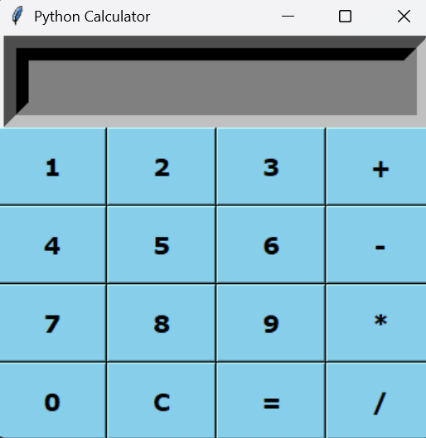
GUI Calculator
MM.DD.YY
Presented By : Deepti Chaudhary

Slide 2
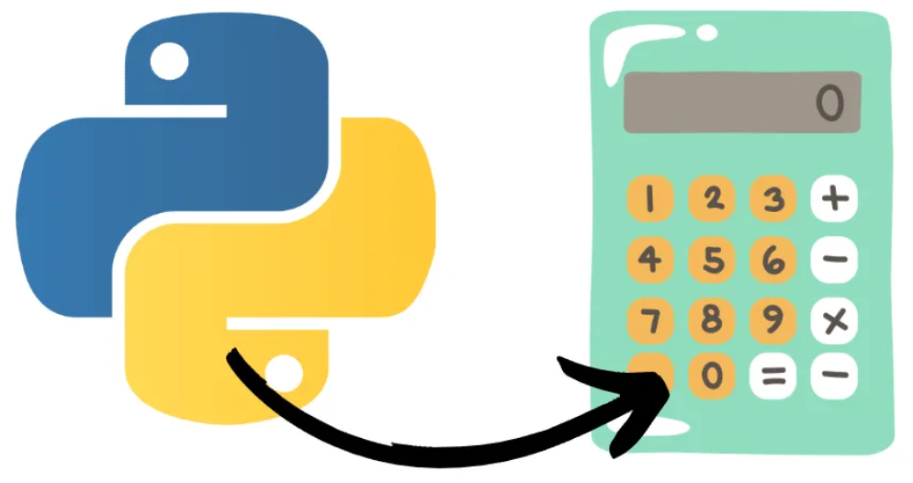
Introduction
A simple calculator program using Tkinter.
Built using python programming language.
Provide Basic arithmetic operations with a user-friendly interface.
Performing basic operations (Addition, Subtraction, etc.)

Slide 3
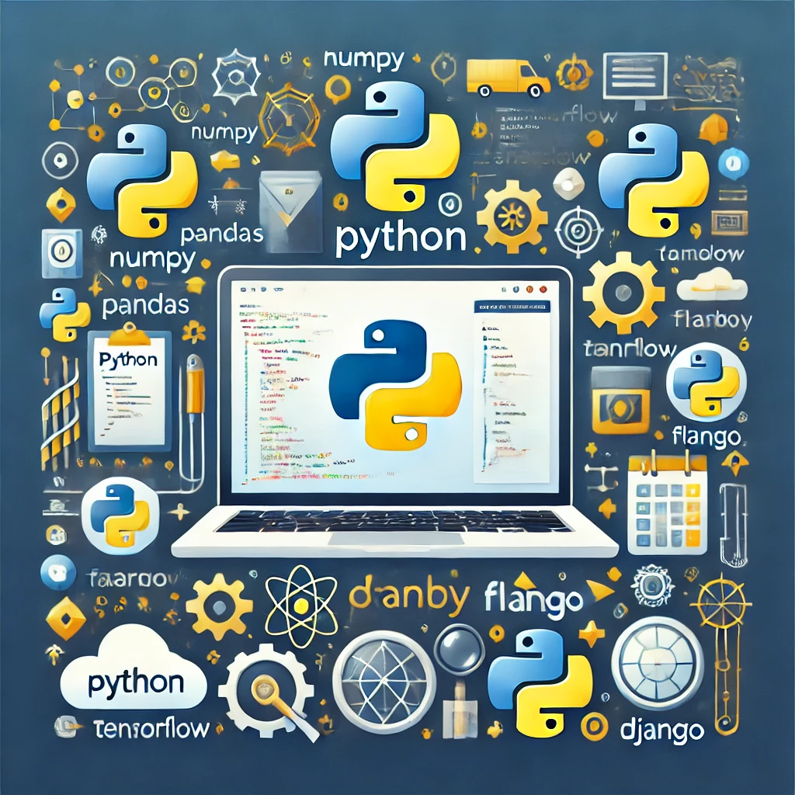
Tools and Technologies
Tools – Python , PyCharm
Python Libraries – Tkinter , etc.
Tkinter – Tkinter is the standard GUI library for Python. Tkinter provides a powerful object – oriented interface to the Tk GUI toolkit.

Slide 4
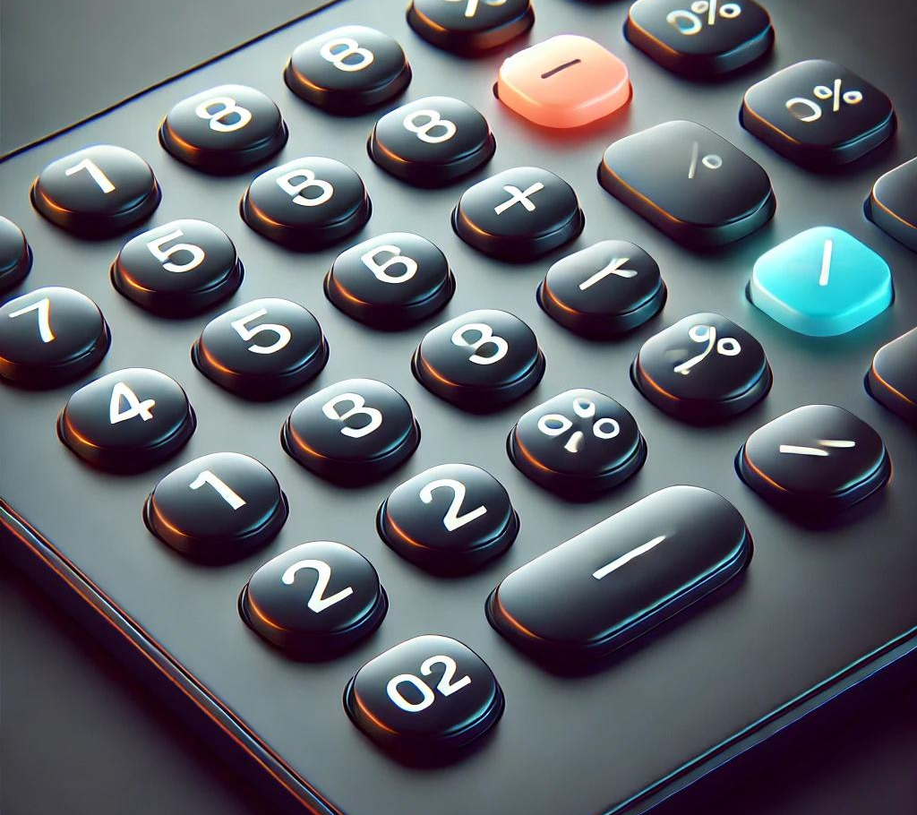
GUI Components in Tkinter:
Widgets : Tkinter offers various widgets .
Tk() – Creates the main application window.
Entry – Used to display user input and results.
Button – Number keys (0-9) and operation keys (+, -, *, /, =, C).
Frame – Organizes buttons into a grid layout.
Grid – Arranges buttons properly in rows and columns.
Layout Management : Tkinter provides geometry managers such as pack, grid, and place to arrange widgets within the window.

Slide 5
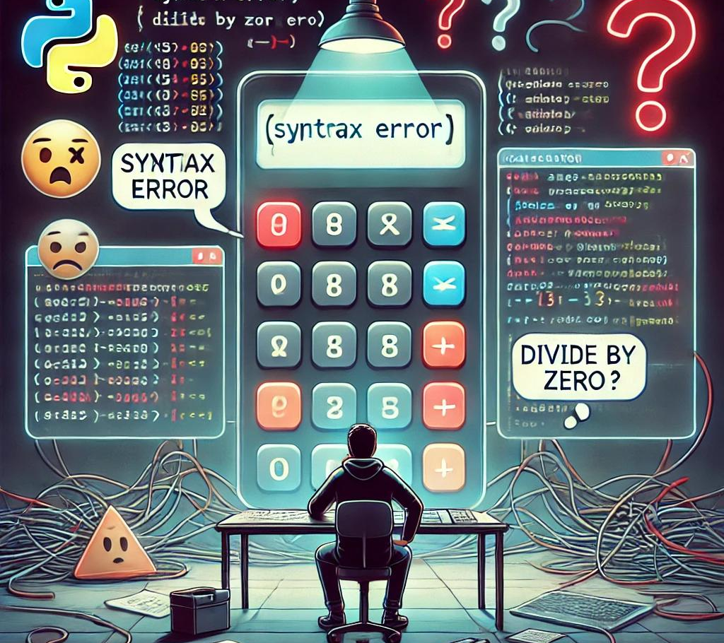
Challenges & Error Handling :
Aligning buttons, text fields, and other widgets properly.
Maintaining a responsive layout across different screen sizes.
Ensuring valid numerical input.
Creating a proper mathematical evaluation system. Handling division by zero (1/0 error).
Implementing a clear button to reset input.

Slide 6
Knowledge Hub :
Geeksforgeeks for Tkinter.
Chatgpt for basic knowledge
Youtube for Layout and Buttons management.
Online tutorials.
Python Documentation and Libraries.

Slide 7
Thank You

